Slide 1
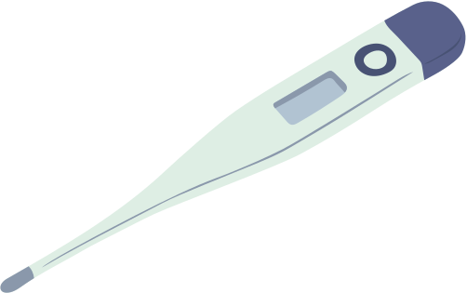
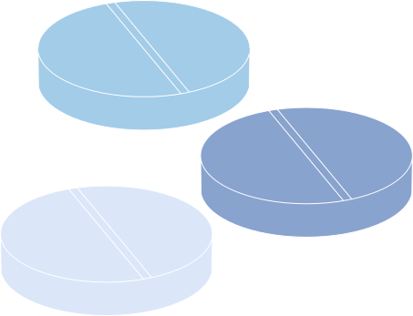


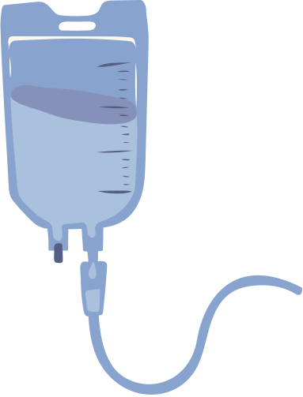




KogniCare
AI-Integrated Patient Monitoring System using Bayesian Reasoning
An AI-based healthcare solution for real-time monitoring and probabilistic diagnosis
23R11A66H7 - Kuppili Nikhilesh Raju

Slide 2



Introduction
Healthcare systems often face challenges like limited staff, delayed responses, and manual errors.
This project proposes an AI-integrated patient monitoring system that continuously tracks vitals and predicts potential health risks.
It leverages Bayesian reasoning to analyze uncertain medical data and support doctors in decision-making.
The model ensures timely alerts, improved accuracy, and reduced workload on medical staff.

Slide 3
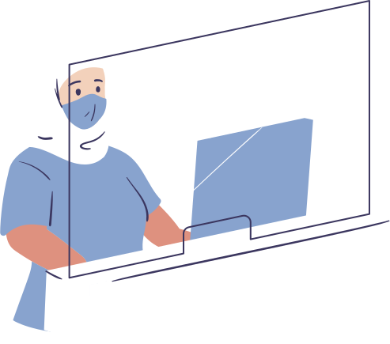

Objective
Bayesian AI model that enables real-time monitoring and intelligent health prediction for patients.
Simulate patient vital data such as heart rate, temperature, and oxygen levels.
Apply Bayesian inference to estimate the likelihood of medical conditions.
Build a Flask-based dashboard for visualization and interaction.
Generate alerts and reports based on probabilistic analysis.

Slide 4
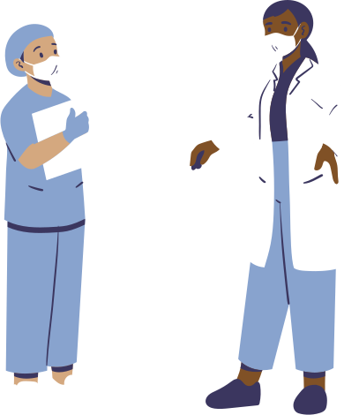
Implementation Overview
Project Architecture:
AI-PBL/
├── app.py → Main Flask application
├── src/
│ ├── models/
│ │ └── bayesian_network.py → Core Bayesian logic
│ ├── services/
│ │ ├── vitals_service.py → Vitals simulation
│ │ ├── ai_service.py → AI + reasoning layer
│ │ └── uncertainty_service.py → Bayesian inference
│ └── routes/
│ └── api.py → API endpoints
├── templates/
│ └── index.html → Dashboard UI
└── docs/ → Documentation
Workflow:
Vitals data simulated in real-time
Bayesian model calculates disease probabilities
Flask API integrates backend logic with dashboard
Results displayed with visual alerts

Slide 5
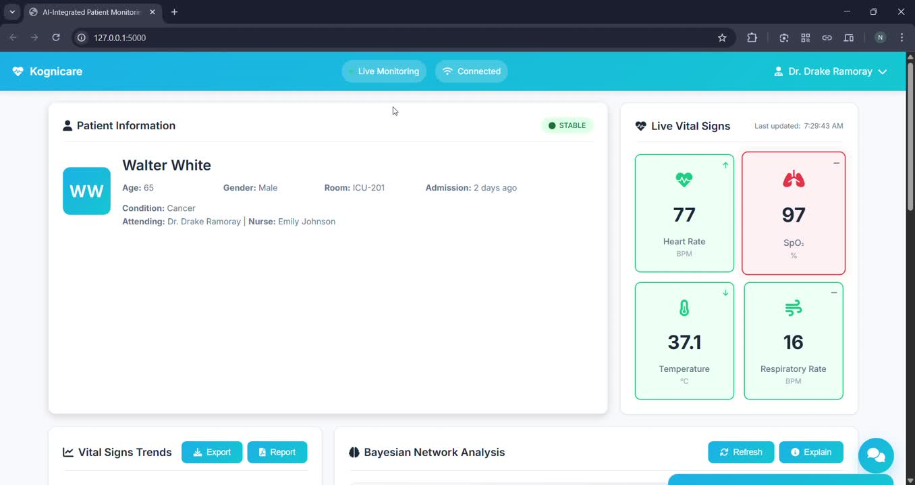
Prototype

Slide 6


Challenges
Handling uncertainty in real-world medical data.
Ensuring real-time analysis and system responsiveness.
Managing inter-module communication between AI, Flask, and frontend.
Maintaining accuracy and interpretability in predictions.
Designing a scalable and clean architecture for future improvements.

Slide 7
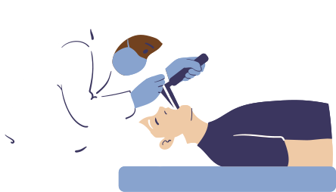
Applications
Hospitals: Automated monitoring and alert systems for patients.
Telemedicine: Remote patient care with intelligent risk analysis.
ICU Systems: Predictive alerts for critical health events.
Home Healthcare: Integration with wearables and IoT sensors.
Research: Testing AI decision-making models in healthcare data.

Slide 8


Future Scope
Integration with real-world hospital databases.
Use of deep learning for advanced pattern recognition.
Deploying models on IoT/edge devices for remote access.
Expansion to multi-patient monitoring and centralized dashboards.
Enhanced visualization with AI explainability for medical experts.

Slide 9


Conclusion
Developed a modular AI-driven monitoring system powered by Bayesian reasoning.
The system demonstrates real-time data analysis and probabilistic health prediction.
Aims to support doctors in decision-making and reduce manual effort.
Provides a strong foundation for smart, scalable, and proactive healthcare systems.

Slide 10
Thank you

